Slide 1
Generating Queries from User-Selected Text
Date : 2013/03/04
Resource : IIiX’12
Advisor : Dr. Jia-Ling Koh
Speaker : I-Chih Chiu

Slide 2
Outline
Introduction
Approaches
Experiments
Conclusion

Slide 3
Outline
Introduction
Motivation
Goal
Flow Chart
Approaches
Experiments
Conclusion
Notes:
Motivation :
Goal :
Flow chart : 介紹什麼是chunk、處理過程

Slide 4
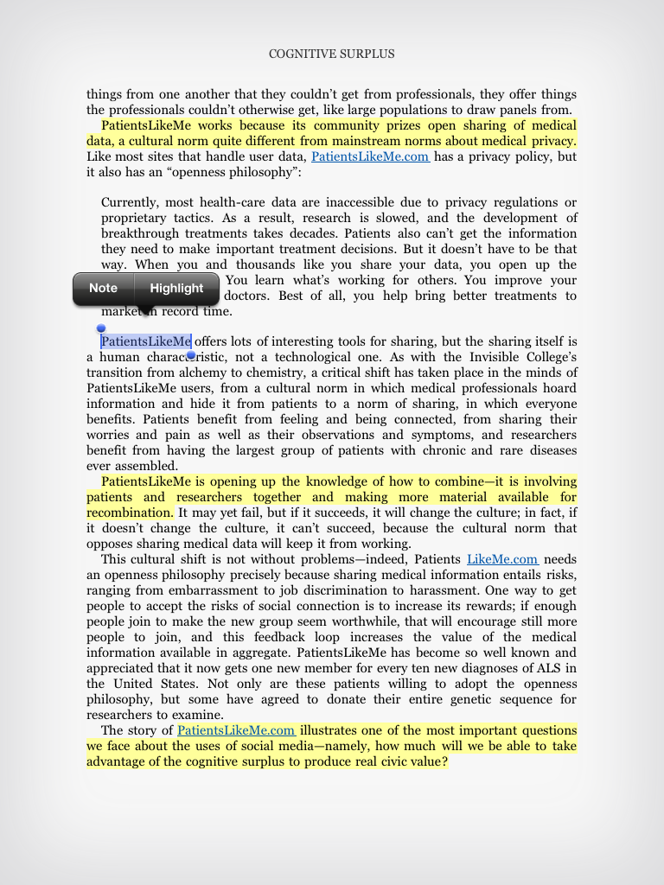
Motivation
Annotation, which are becoming more common in various tablet applications, can help improve understanding content.
Queries constructed from the annotated texts can be very effective.

Slide 5
Motivation
Manual query construction based on text passages is common; however, such formulation can involve considerable effort for users and an effective search is not guaranteed.
Past researches
Log history
Relevance feedback
More-like-this

Slide 6
Goal
Authors propose techniques for generating queries from user-selected or annotated text passages.
A user can select any arbitrary text segment of interest while browsing, and then automatically generate queries based on that text segment.

Slide 7
Flow Chart
The use of noun phrases or named entities as the minimum semantic building blocks has proven to be reliable in past research on information retrieval and natural language processing.
Authors propose to identify important noun phrases and named entities, called “chunks“, within the selected text segment as the basic building blocks for query formulation.

Slide 8
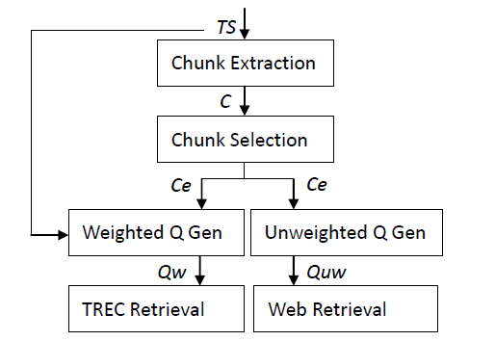
Flow Chart
TS : Text Segment
C : Chunks
Ce : effective Chunks
Notes:
Instead of using a word, considering a “chunk” as the unit for the query construction
reduces computational burdens while keeping most of the interesting
content such as preserving text structure and reducing topic drift.

Slide 9
Outline
Introduction
Approaches
Chunk Extraction
Chunk Selection
Query Generation
Experiments
Conclusion

Slide 10
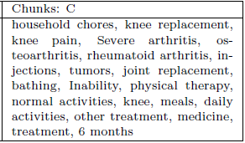
Chunk Extraction

Slide 11
Chunk Selection
Frequency-based approach
Learning-based approach

Slide 12
Frequency-based
chunks
Web search API
$$N=\{n_{1},n_{2},…,n_{n}\}$$
Following the common belief in the effectiveness of term inverse document frequency
$c_{i}$ is considered more important than $c_{j}$ if $n_{i}<n_{j}$
Based on the number of returned results
select the top k most infrequent chunks → $C_{e}$

Slide 13
Learning-based
CRF-perf model (Conditional Random Field)
To identify important chunks in C
Features
Labeling problem
Each chunk $c_{i}∈C$, $L=\{l_{1},l_{2},…,l_{n}\}$
$l_{i}=1$ and $l_{i}=0$ means “keep” and “don’t keep” respectively.

Slide 14
Learning-based
CRF-perf model
In the training phase, the model parameters $θ=\{λ_{j}\}$
$$P\left(L | C\right)=\frac{exp⁡(\sum_{j=1}^{J}{λ_{j}f_{j}}(L,C))}{Z(C)}$$
$f_{j}$ : the features
$λ_{j}$ : the weight of $f_{j}$
$J$ : the number of features
$Z(C)$ : a normalizer
$$Z\left(C\right)=\sum_{L}{exp⁡(\sum_{j=1}^{J}{λ_{j}f_{j}(L,C)})}$$
$m(L)$ : the retrieval performance(MAP)
$l(θ)$ : log-likelihood
$R$ : a regularization avoids
unbounded parameter values.
$$Obj\left(θ\right)=\prod_{C}{\sum_{L}{P\left(L | C\right)m(L)}}$$
$$l\left(θ\right)=\sum_{C}{log\sum_{L}{\exp\left(\sum_{j}{λ_{j}f_{j}\left(L,C\right)}\right)}m\left(L\right)−\sum_{C}{logZ\left(C\right)}−R}$$

Slide 15
Learning-based
For example
C = {Taiwan, baseball player, money}
L have eight combinations, “keep” or “don’t keep”
L = {1,1,0}
$$f_{1}\left(L,C\right)=0.21 , λ_{1}=0.15$$
$$f_{2}\left(L,C\right)=0.3 , λ_{2}=0.17$$
$$Z\left(C\right)=0.8$$
$$P\left(L | C\right)=\frac{exp⁡(0.15∙0.21+0.17∙0.3)}{0.8}$$
$$P\left(L | C\right)=\frac{exp⁡(\sum_{j=1}^{J}{λ_{j}f_{j}}(L,C))}{Z(C)}$$
$$Z\left(C\right)=\sum_{L}{exp⁡(\sum_{j=1}^{J}{λ_{j}f_{j}(L,C)})}$$

Slide 16
Select effective chunks
Three ways construct the final chunk set $C_{e}$
CombC
The chunk combination with the highest probability $P_{c}$
$C_{e}=\{Taiwan, basebal player\}$
CombC + TopC(2)
Select two top-performing single chunks with the highest probability $P_{c}$
$C_{e}=\left\{Taiwan,baseball player\right\}+\{baseball team,coach\}$
TopC(k)
It contains the top k effective chunks by algorithm.
$C_{e}=\{baseball team,coach,baseball player\}$

Slide 17
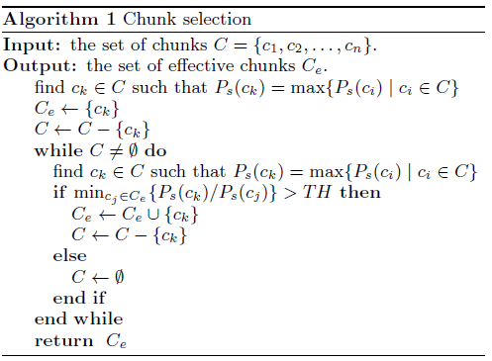
Select effective chunks
TopC(k) (${CRF}_{SingleC}$)
Threshold = 0.42

Slide 18
Query Generation
${TS}_{n}+WeightC(20)$
According to frequency based approach
$w_{i}=\frac{r_{i}}{\sum_{i}{r_{i}}}$ , $r_{i}=\frac{1}{n_{i}}$ , $n_{i}$ : document frequency
${TS}_{n}+CombC$
The query is generated by combining the best chunk combination (max $P_{c}$) with ${TS}_{n}$
${TS}_{n}$ denotes the corresponding
$TS$ with no stopwords.

Slide 19
Query Generation
${TS}_{n}+CombC+{TopC}_{w}(2)$
Based on the ${CRF}_{combC}$ model
${TopC}_{w}\left(2\right)=\sum_{i=1}^{2}{w_{i}c_{i}}$ , $w_{i}={P_{c}(c_{i})}/{\sum_{i=1}^{2}{P_{c}(c_{i})}}$
${TS}_{n}+TopC(k)$
Using model ${CRF}_{SingleC}$ and Algorithm

Slide 20
Outline
Introduction
Approaches
Experiments
Conclusion

Slide 21
Experiment
Experimental Setup
TREC Gov2 collection
25205179 documents
Average number of words in text segments and documents before/after removing stopwords for the selected 50 topics.
Use 10-fold cross validation for training and testing the CRF-perf models.

Slide 22
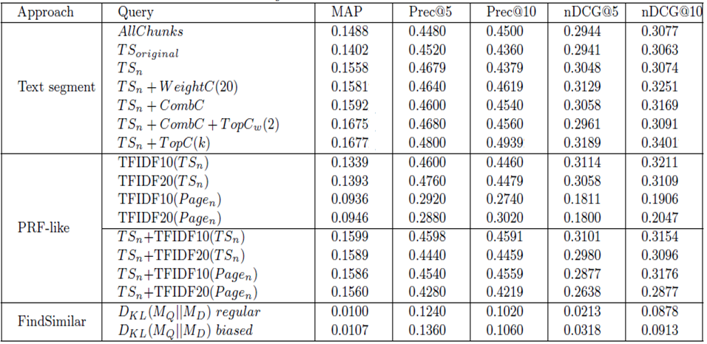
Experiment
PRF(Pseudo relevance feedback) : extract the top 10 and 20 tf-idf weighted terms from ${TS}_{n}$

Slide 23
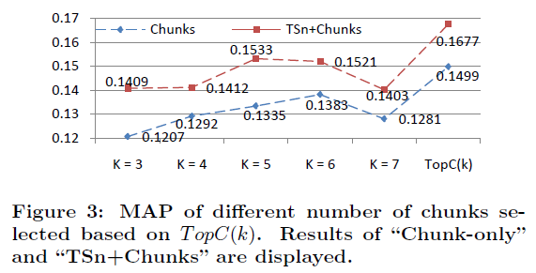
Experiment
TopC(K)
average k value is 3.85.

Slide 24
Outline
Introduction
Approaches
Experiments
Conclusion

Slide 25
Conclusion
They present approaches for generating queries based on user-selected text segments from a document.
They propose several learning-based approaches to selecting effective chunks from the text segments.
In the experiments, the technique TopC(k) has the advantage of automatic determination of k can significantly improve retrieval performance.

Slide 26
Thanks for your listening

